Slide 2



ISACA
Belgium Chapter
Advancing the Best in Global Technology
Kian BAYAT
Board Member
Director of Academic RelationsR
ISACA in 2021

Slide 3
We are a
Learning Community

Slide 4




We are a Global Community
48%
North America
20%
Europe
20%
Asia
3%
Central/South
America
3%
Oceania
180K+
5%
Africa
MEMBERS

Slide 5







ISACA Certifications
Best Professional Certification
Program
SC Awards 2024
Best Professional Certification
Program
SC Awards 2024
Global Knowledge’s 2022 Highest-Paying Cybersecurity Certifications
#1
#2
#4
CRISC
CISM
CGEIT

Slide 6




In Pursuit of Digital Trust
Privacy
Security
Risk
Quality
Governance
Assurance
DIGITAL TRUST CONFERENCE 20th of March 2025
Visit : https://isaca.be/events/digital-trust-conference-2025/

Slide 7
Cyber Risk Management
A Quantification in Financial Terms

Slide 8

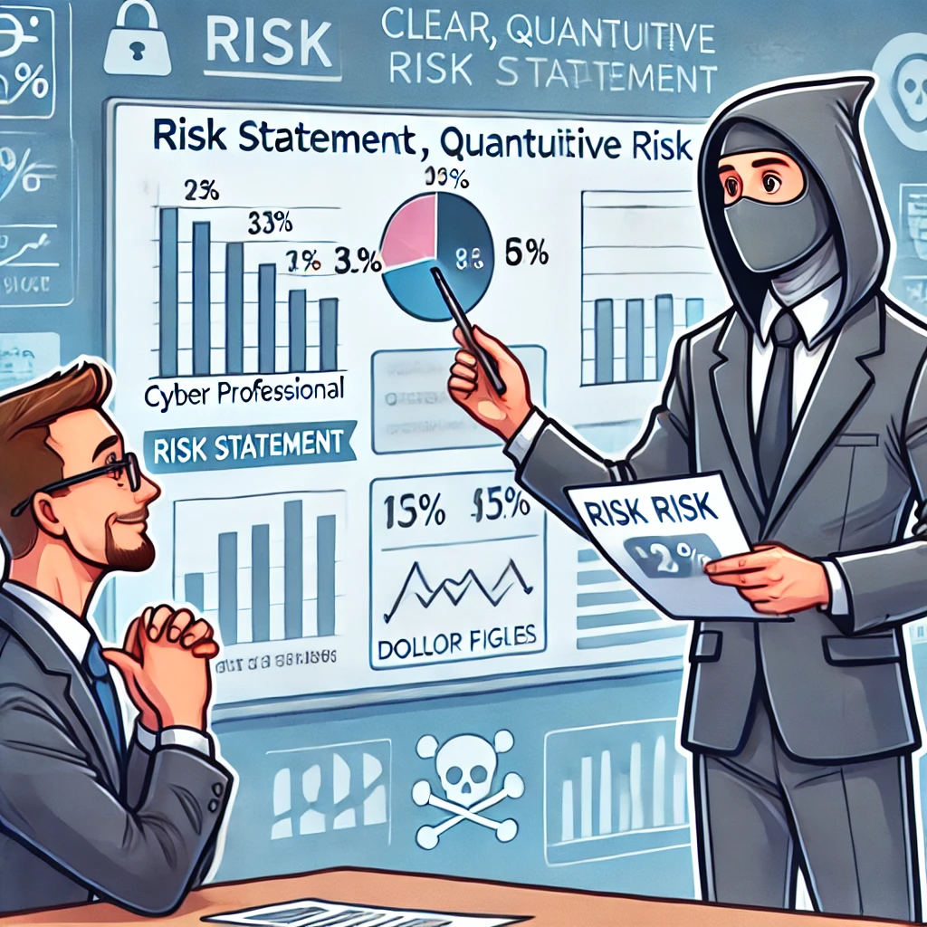
Expressing High Risk in Financial Terms
A Clearer Path for Investment Decisions
Image generated by AI : These images are created for presentation purposes only and are not affiliated with or endorsed by ISACA.

Slide 9
Risk Definition
Various risk definitions in the context of cybersecurity, selected for their wide recognition and relevance across multiple industries and frameworks.
Risk is the combination of the probability of an event and its consequence. (ISO/IEC 73)
Risk is the effect of uncertainty on objectives.
(ISO 31000:2018)
Risk is the possibility that events will occur and affect the achievement of strategy and business objectives.
(Committee of Sponsoring Organizations of the Treadway Commission - COSO)
Risk is the potential for loss or damage when a threat exploits a vulnerability.
(Information Systems Audit and Control Association - ISACA)

Slide 10
Cyber Risk Management Life Cycle
Setting Context
Risk Reporting and Communication
Risk Identification
Risk Response and mitigation
Risk Assessment

Slide 11
Risk Assessment
Identify Threats
Threat identification requires understanding the motivation, strategy, and techniques of those who perpetrate threats.
Risk Analysis
Risk analysis is modeling various threats against assets to estimate frequency and magnitude of resulting impact to assets.
Risk Evaluation
Risk evaluation is comparing the risk analysis against given risk criteria to determine the significance of the risk.
Notes:
Facilitator Notes:
The first step in avoiding a threat is identifying it. Knowledge of threats and the motivations, strategy and techniques of those who perpetrate threats is key, so that a threat may be managed before it becomes reality. An enterprise needs to know its own weaknesses, strengths, vulnerabilities and the gaps in the security fabric. Security must be woven into each business process, each IT system and all operational procedures. Any gaps in the security fabric can easily be exploited. The better the risk practitioner understands the mind of the attacker or the source of the threat, the more effective the risk management activities will be in countering the threat.
Risk analysis is the modeling of various threats against assets, estimating the probability of a loss event occurring and the resulting impact on an asset, if the risk event were to be realized within an environment, and needs to consider technical and non-technical threats. When performing a risk analysis critical thought needs to be given relating to the various elements:
Risk evaluation is the consideration of risk events identified within the analysis, in context of the enterprise’s defined risk appetite, tolerance criteria and capacity, and should consider the entire risk environment when evaluated. Risk is often influenced more by lack of training than by lack of equipment. In many cases, the risk is related to the way the equipment is operated more than whether the right tools are available.
To read more about each of these processes, refer to the participant guide

Slide 12







Quantifying Risk
Productivity
Damaged Reputation
Response Costs
Impaired Growth
Legal and Regulatory
Health, safety, environment
Competitive Advantage

Slide 13
Qualitative vs Quantitative: Cyber Risk Analysis
Comparisons
Qualitative
  Based on Judgment, Intuition, and Experience
  Depends on the human factor
  Relative Ranking
  Better for evaluating intangible risks
  Can go faster and is cheaper
Quantitative
  Data Driven,
  Supports Cost/benefit analysis
  Comparison can be made between two different sets of data or observations
  Objective assessment
  Financial Focus

Slide 14
Combine both approaches
Combining both approaches is often the most effective strategy for comprehensive risk assessment.
Step 1: Use the qualitative approach to quickly identify most risks.
Step 2: Apply the quantitative approach to the highest risks for more detailed analysis and decision-making.
Like a doctor’s process : start with simple questions (qualitative), then decide which detailed exams (quantitative) are needed based on initial findings.

Slide 15
Qualitative Cyber Risk Analysis
KISS (Keep It Super Simple):
Suitable for smaller, straightforward systems or operations.
Uses a simple scale (e.g., very high to low) to assess risk, ideal for teams with limited risk assessment experience.
Probability/Impact
For larger, more complex systems or operations. Assesses the likelihood (probability) and effect (impact) of risks.
Risk score is calculated by multiplying probability and impact, using a scale (e.g., 1 to 10).

Slide 16
Quantitative Cyber Risk Analysis
For high risks, to reach a monetary result, quantitative risk assessment often makes use of these concepts:
  AV (Asset Value), refers to the financial worth of a resource, system, or data that could be impacted by a cyber threat.
  EF (Exposure factor), which is the percentage of asset loss caused by the identified threat.
  SLE (Single Loss Expectancy), money expected to be lost if the incident occurs one time.
  ARO (Annual Rate of Occurrence), how many times in a one-year interval the incident is expected to occur.
  ALE (Annual Loss Expectancy), money expected to be lost in one year considering SLE and ARO (ALE = SLE * ARO).

Slide 17
Justifying Cybersecurity Investments
through Quantitative Risk Assessment
Annual Loss Expectancy (ALE) supports better decision-making by comparing potential financial losses from cyberattacks to the cost of preventive measures
The next slides will explore a hypothetical phishing attack scenario in an industrial environment
We will demonstrate how investing in preventive measures impacts the ALE, showing the financial benefits of reducing risk.
Original ALE ➡ Investment (Controls) ➡ New ALE ➡ Net Savings ➡ ROI
* Disclaimer: The financial estimates provided (SLE, ALE, ARO) are illustrative and based on general trends on cyber-attacks, not official data.

Slide 18
Key Elements in Phishing
Quantitative Risk Assessment
Asset Value (€) and Single Loss Expentancy (SLE)
Asset value is the value of tangible or intangible assets under risk.
The asset in a phishing attack could represent sensitive data, system access credentials, or business operations.
The SLE of an attack could be linked to potential data breaches, incident management, investigation, operational disruption, recovery, and reputational damage.“
Exposure Factor (EF)
The EF reflects how much of the asset is impacted in the phishing attack. If attackers gain partial access or the attack is quickly contained (e.g., affecting only a portion of the system), the EF is less than 100%.

Slide 19
Phishing Attack Risk Calculation
AV, EF, SLE, ARO, and ALE Breakdown
Metric | Value | Formula/comments
Asset Value (€) | €500,000 | (Given)
Exposure Factor (EF) | 0.50 (50%) | (Given)
SLE (Single Loss Expectancy) | €250,000 | SLE = Asset Value × EF = 500,000€ × 0.50
ARO (Annual Rate of Occurrence) | 0.33 (1 attack every 3 years) | Based on Industry benchmarks
ALE (Annual Loss Expectancy) | €82,500 | ALE = SLE × ARO = 250,000€ × 0.33

Slide 20
Phishing Attack Risk Calculation
Impact of Security Investment: New ALE, Savings, and ROI
Metric | Value | Formula/comment
Investment Cost (€) | €120,000 | (Given)
New ARO | 0.2 (1 attack every 5 years) | Reduce the likelihood of an attack
New ALE (€) | €50,000 | New ALE = SLE × New ARO = €250,000 × 0.20
Net Savings (€) | €48,010 | Net Savings = Original ALE (€98,010) - New ALE (€50,000)
ROI (%) | 40% | ROI = (Net Savings / Investment Cost) × 100

Slide 21
Aligning Cybersecurity with Business Goals
Bridge IT and Business: Quantifying cyber risks in financial terms fosters clear communication between security teams and business leaders.
Resource Allocation: Use SLE and ALE models to focus on high-impact risks and allocate cybersecurity budgets effectively.
Informed Decisions: Data-driven insights help justify investments and enhance decision-making.
Prepare for Future Threats: Continuously monitor risks to strengthen response strategies and prevent costly incidents.
Embrace a risk-aware culture.
Foster collaboration between business and technical teams to drive business-aligned security strategies.

Slide 22
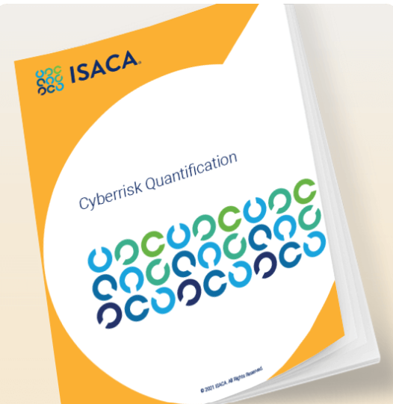
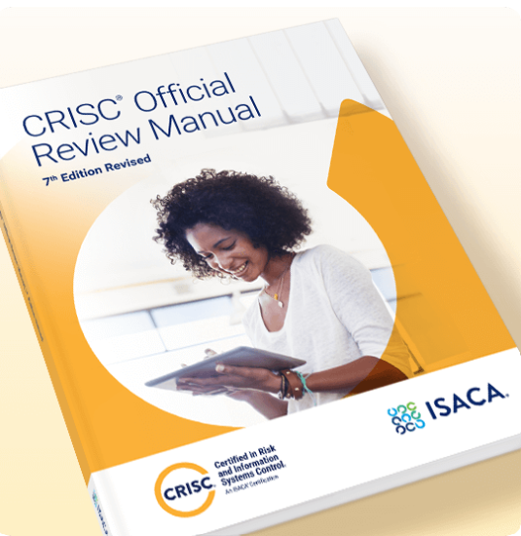
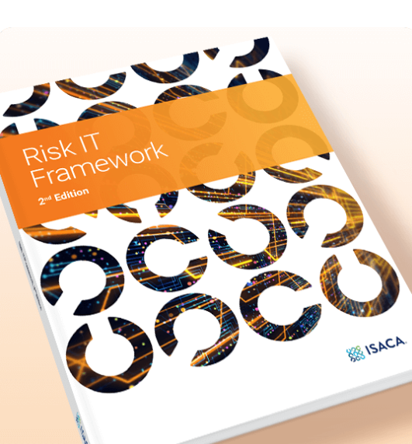
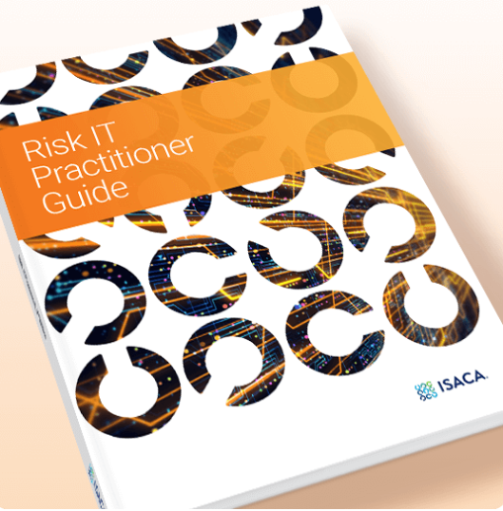
ISACA Ressources used in this presentation
White Paper : Cyberrisk Quantification
CRISC Official Review Manual, 7th Edition Revised eBook
Risk IT Framework, 2nd Edition
Risk IT Practitioner Guide, 2nd Edition

Slide 23
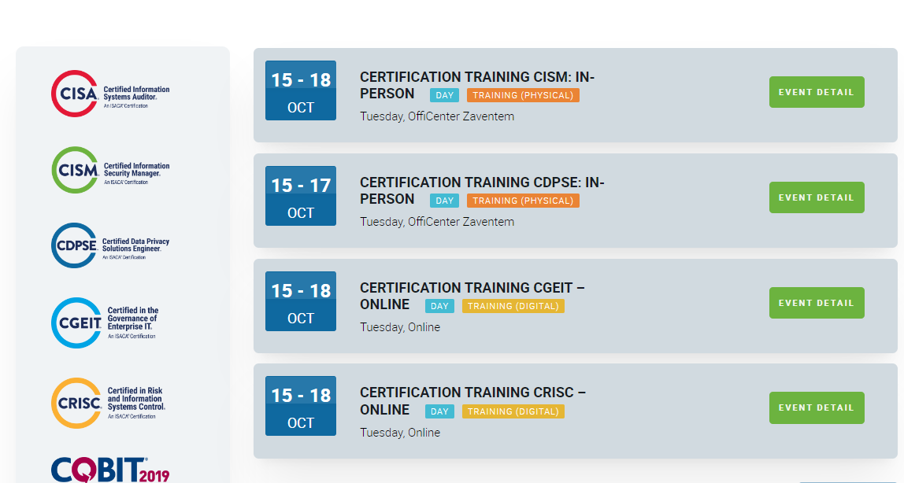
Upcoming ISACA Trainings in Belgium
Registration Deadline: 7th of October
Registration Link: https://isaca.be/events/certification-training-crisc-online/

Slide 24







STAY CONNECTED TO OUR GLOBAL NETWORK

